Slide 1
Min 75-90: Unsupervised Learning for Dimensionality Reduction
Learning Objectives (Géron Ch8):
Distinguish supervised from unsupervised learning
Understand the necessity of reducing dimensionality for big datasets
Know at least two approaches for dimensionality reduction
Understand the steps of Principal Component Analysis

Slide 2
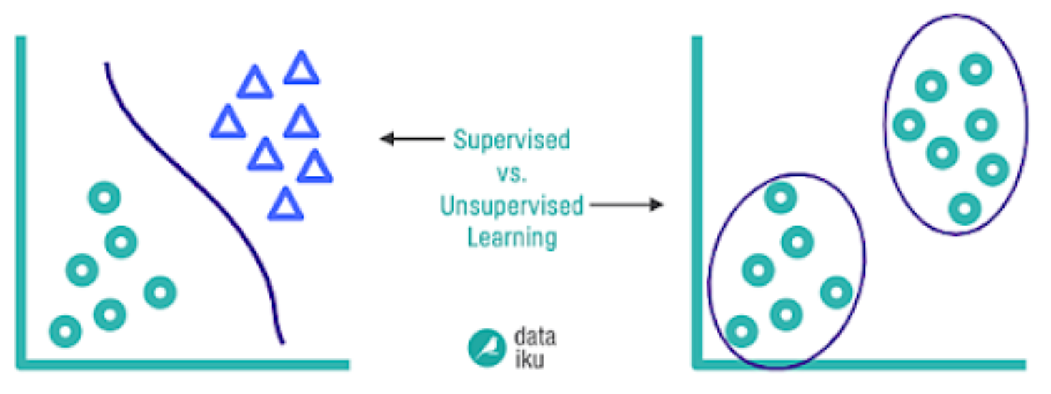
Supervised Learning:
Training set includes desired solutions (labels)
Unsupervised Learning:
Training data is unlabeled
“Learning without a teacher”
Source:
Notes:
VOTE 2) Distinguish supervised from unsupervised
See Géron Ch2 for semisupervised learning, reinforcement learning
Offline vs Online learning
Instance-based vs model-based learning

Slide 3
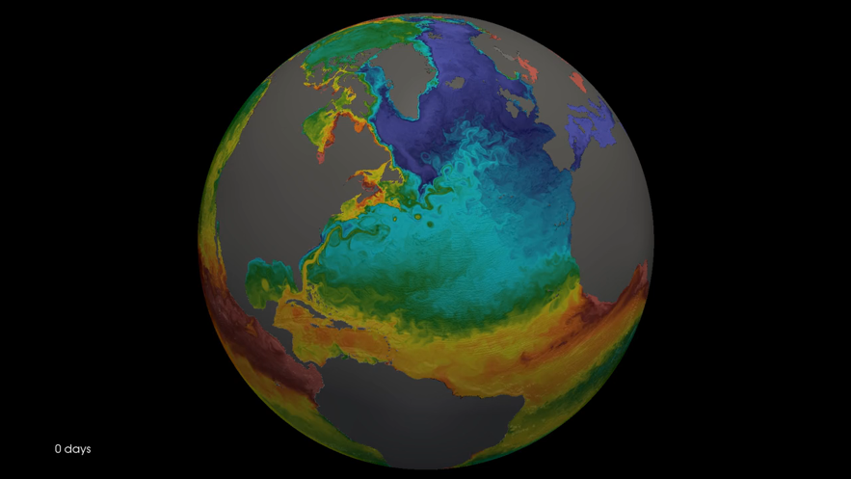


When do we need to reduce dimensionality?
So many possible inputs!
?
How cold will European Winter be?
Surface temp (x,y,t)
Ocean currents (x,y,z,t)
Notes:
First we see the SST, highlighting the fine-scale eddies and filaments present in the simulation.
Then we see density transformation by surface heat fluxes.
Finally we see density transformation by near-surface lateral mixing.

Slide 4
Start with simple statistics!
Global mean surface temperature (t)
Global standard deviation surf. temp (t)
Regional mean surface temperature - Atlantic Ocean temp. (t) - Pacific Ocean temp. (t) - etc.
Play with spatiotemporal coordinates and with various statistical moments (mean, variance, skewness, kurtosis, etc.)
Surface temp (x,y,t)
Ocean currents (x,y,z,t)
Can we be more objective?
Notes:
VOTE

Slide 5
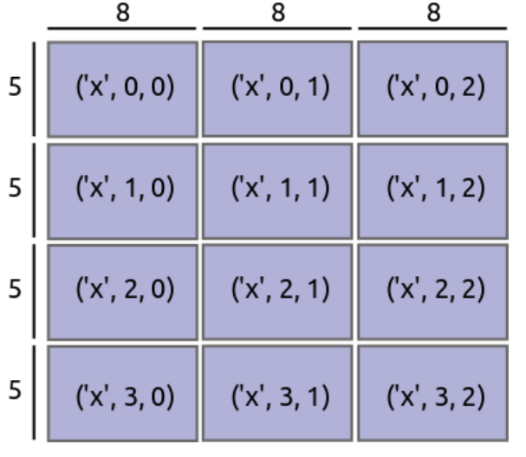
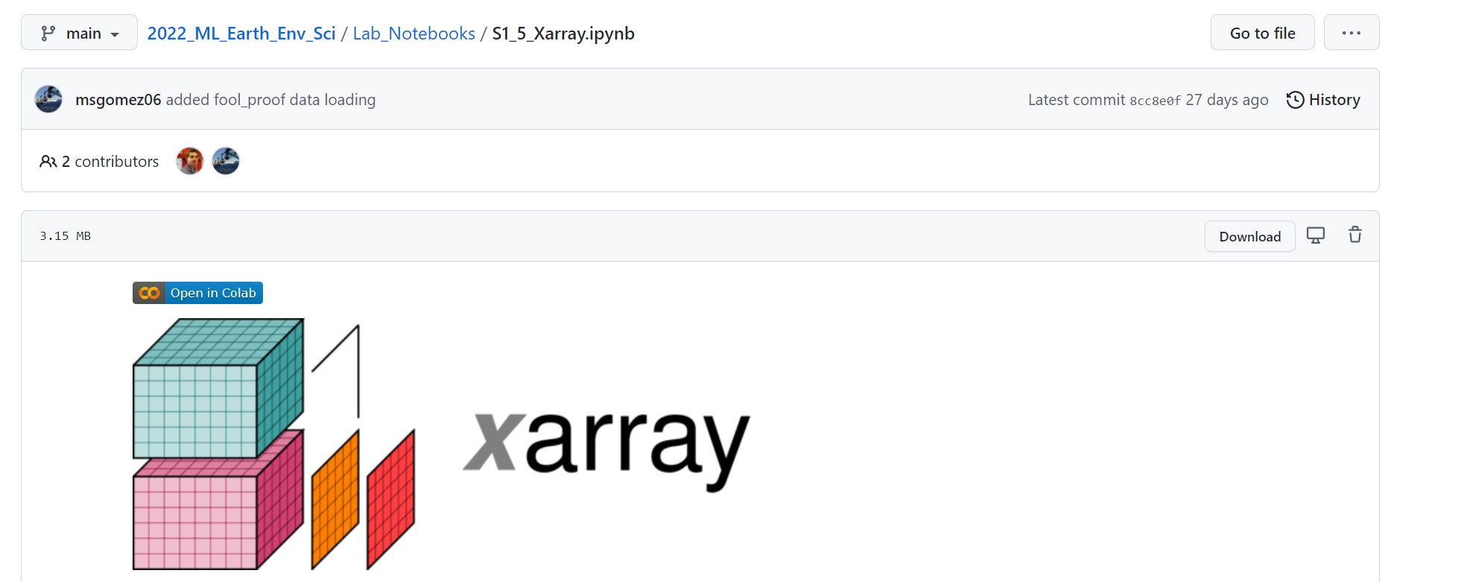
Interlude: What if the data don’t even fit into memory?
xr.open_mfdataset can build pointers to multiple files whose total size far exceeds the RAM!
Can use “dask=True” for parallelization

Slide 6
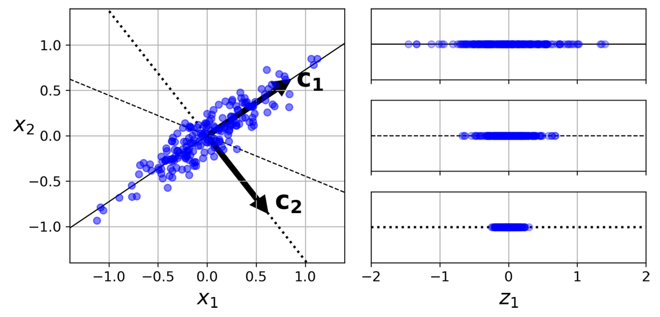
Principal Component Analysis: Decomposing variables to maximize explained variance
First principal component
Second principal component
Notes:
VOTE

Slide 7
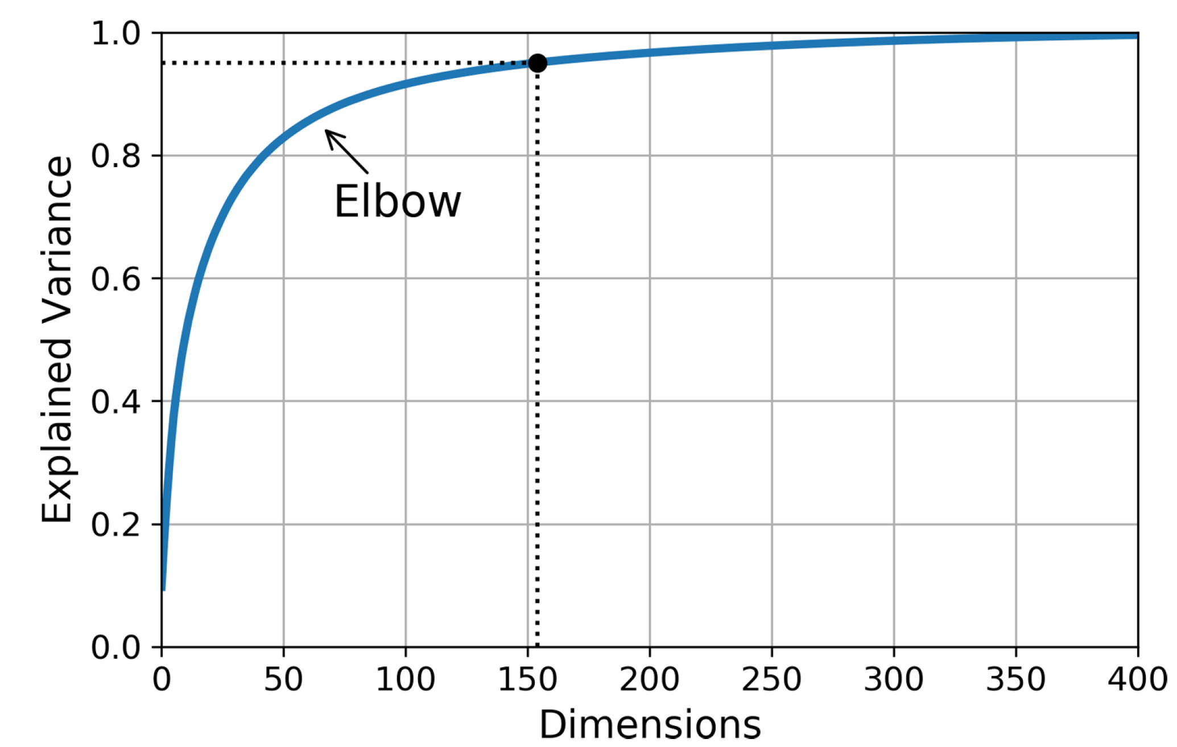
How to choose the number of components?

Slide 8
How to proceed step-by-step?
1. Apply SVD (single value decomposition)on the matrix X to find the matrix of unique vectors V (contains all principal components)
2. Once V is found, you can choose the number of dimensions you want to keep to maximize the variance
3. In the end, matrix multiply the centered X with the transpose V containing the number of dimensions chosen
I would use scikit learn's PCA.
1. I would plot a graph of explained variance / number of dimensions to choose how many dimensions to keep
2. pca = PCA(n_components = chosen number)
3. da = pca.fit_transform(my_data) to fit it on my data.

Slide 9
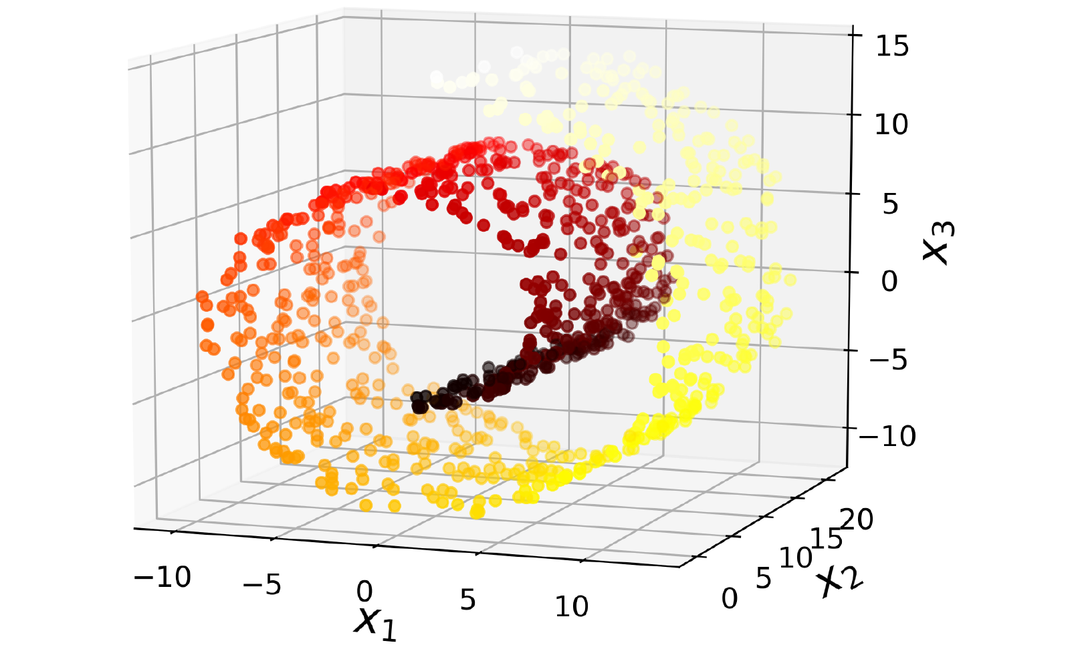

Other Approaches for Dimensionality Reduction
Source: deliciousmagazine.co.uk

Slide 10
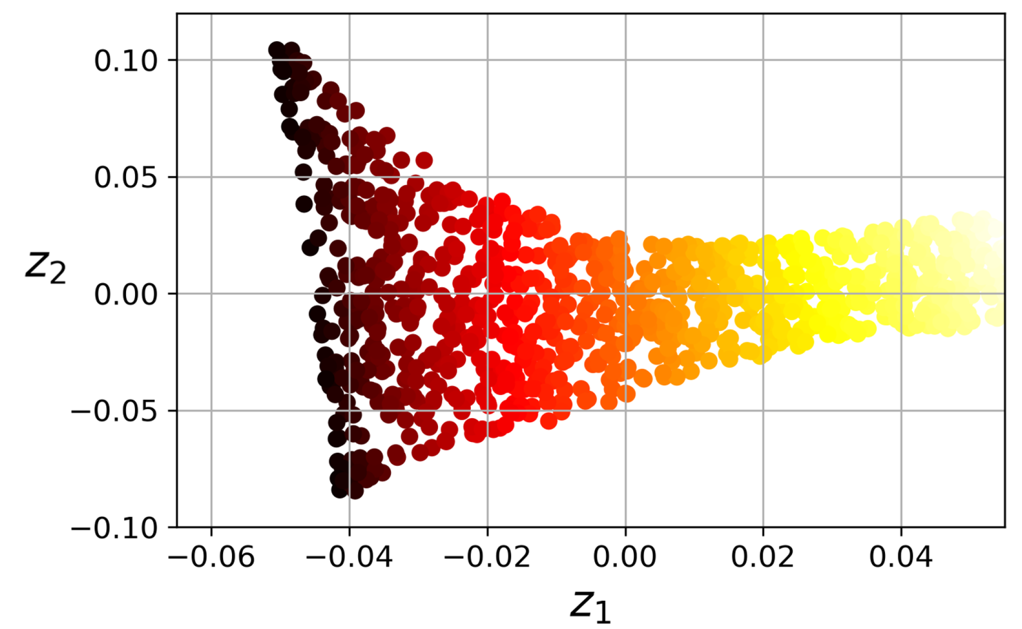
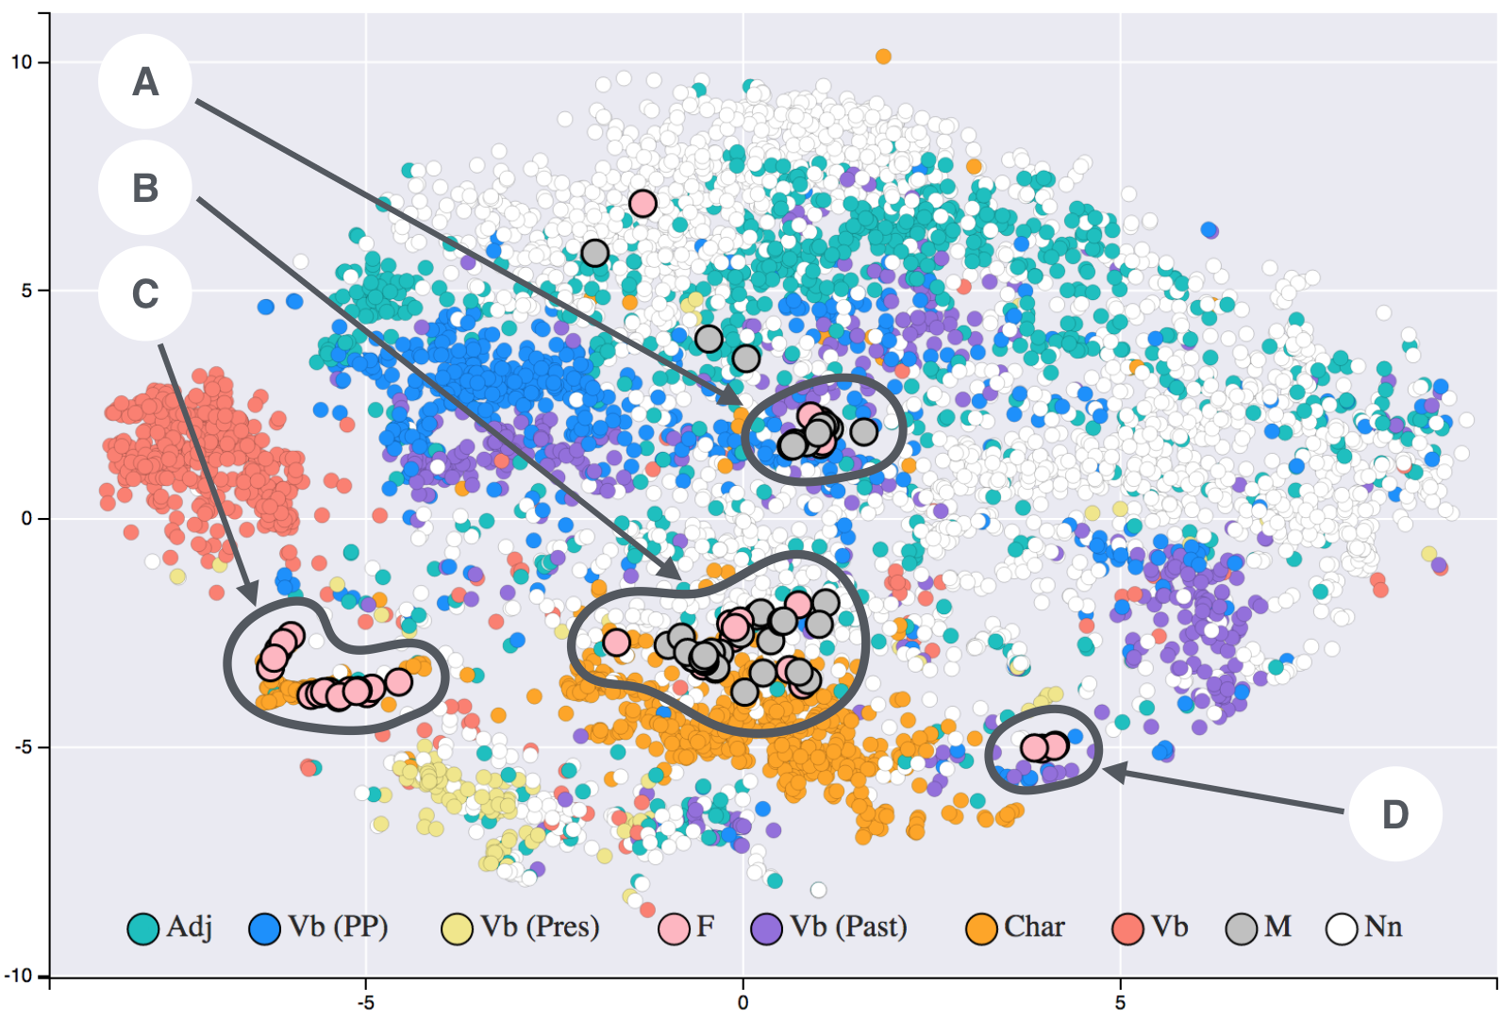
Other Approaches for Dimensionality Reduction
Locally Linear Embedding (LLE)
t-SNE:
t-Distributed Stochastic Neighbor Embedding
Random projection
Source: Siobhán Grayson (Wikipedia, T-SNE)
Notes:
Word embedding algorithms derive a set of real-valued vectors representing the vocabulary of a text corpus in a new embedded space. This provides a useful means of measuring the underlying similarity between words. This image consists of word embeddings generated from 19th century literature.

Slide 11
Min 90-105: Unsupervised Learning for Clustering & Anomaly Detection
Learning Objectives (Géron Ch9):
Distinguish clustering from supervised classification
Know how to implement the K-means algorithm and select the number of clusters
Know how to implement Gaussian mixture models and how to detect anomalies

Slide 12
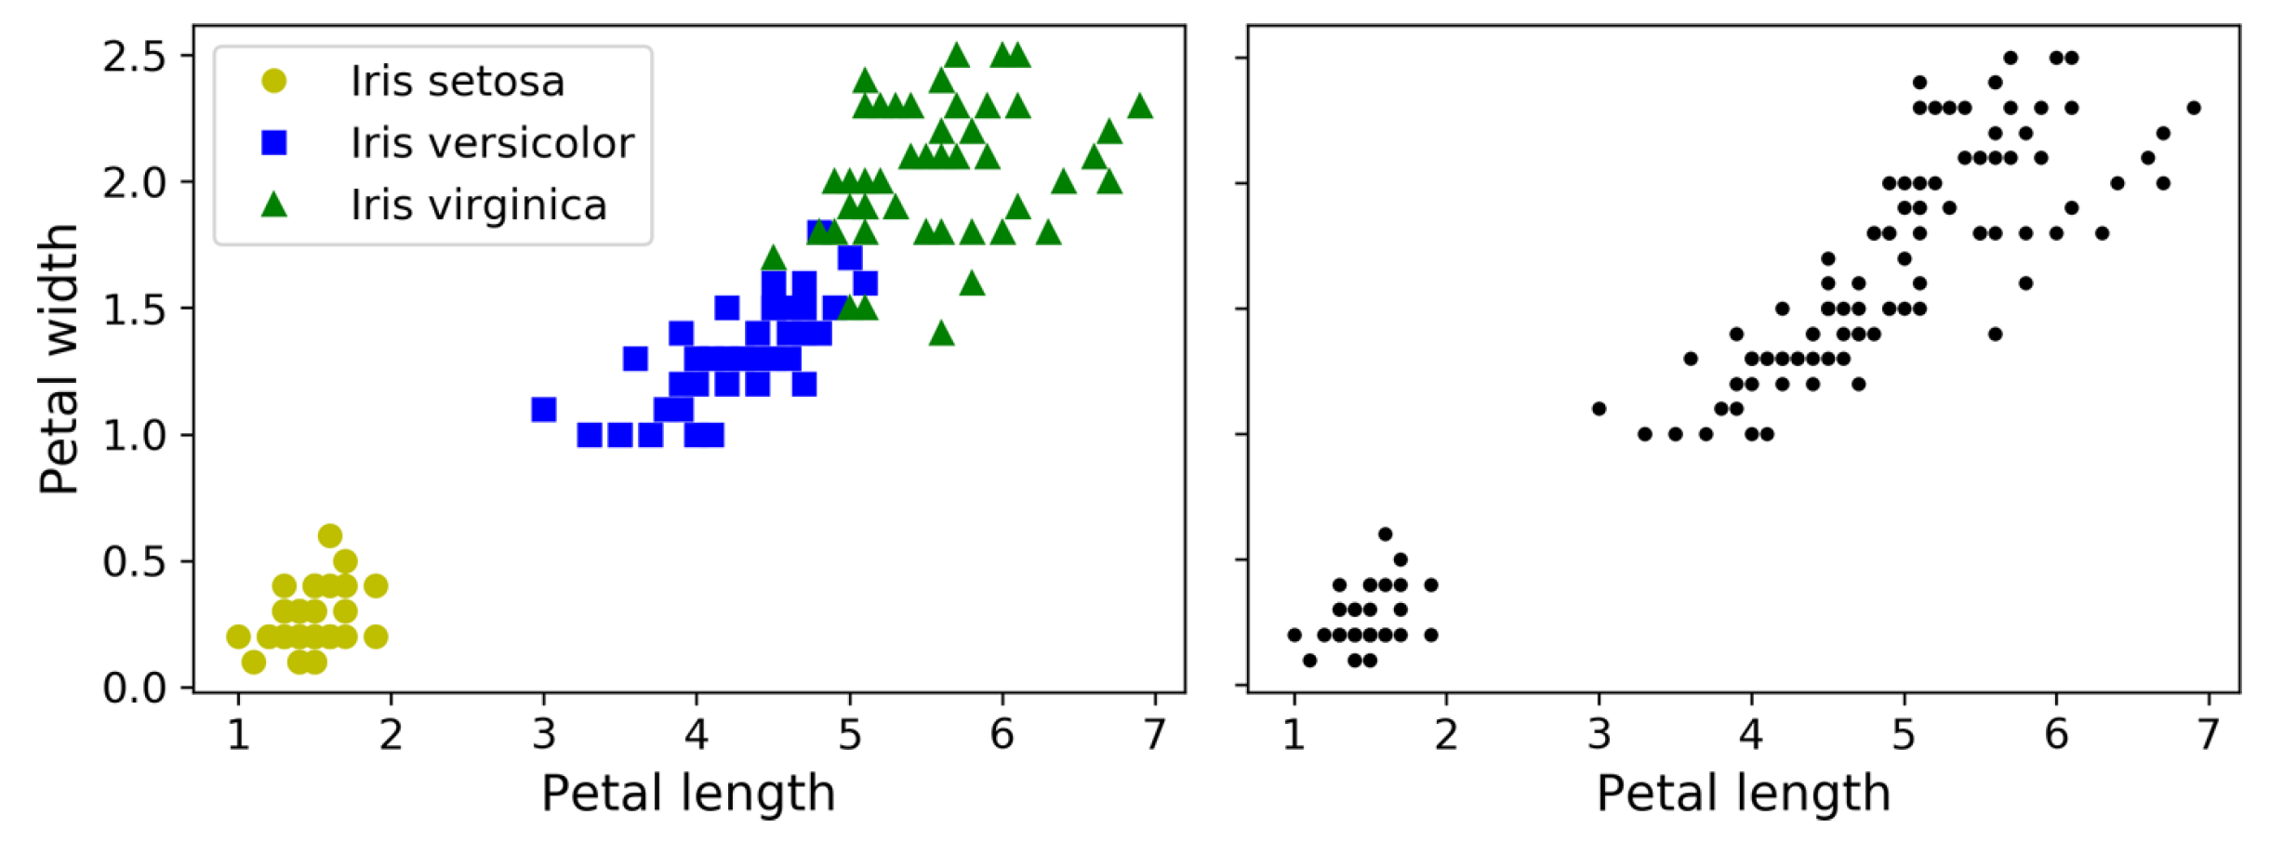
Supervised Classification versus Clustering
Notes:
VOTE

Slide 13
Supervised Classification versus Clustering Data Analysis, Dim. Red., Anomaly Detection, etc.

Slide 14
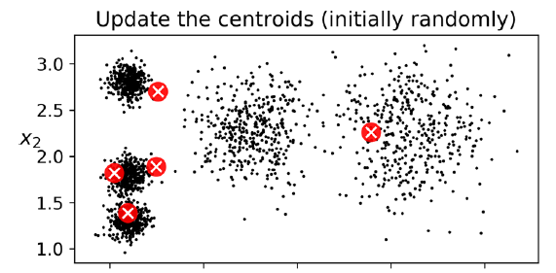

Slide 15
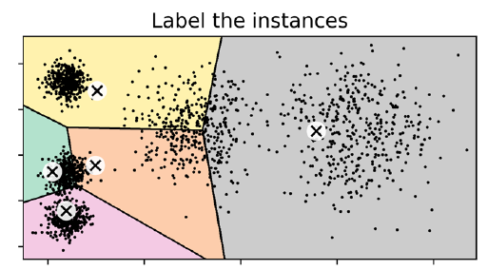

Slide 16
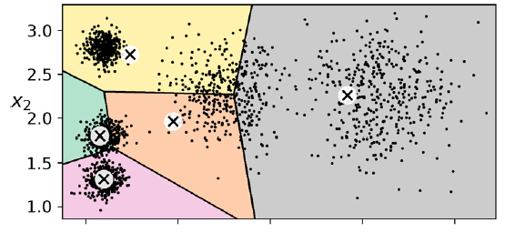

Slide 17
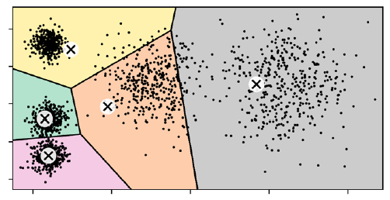

Slide 18
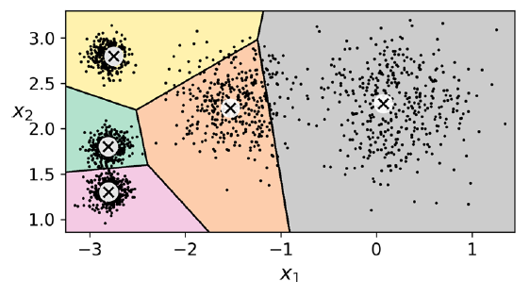

Slide 19
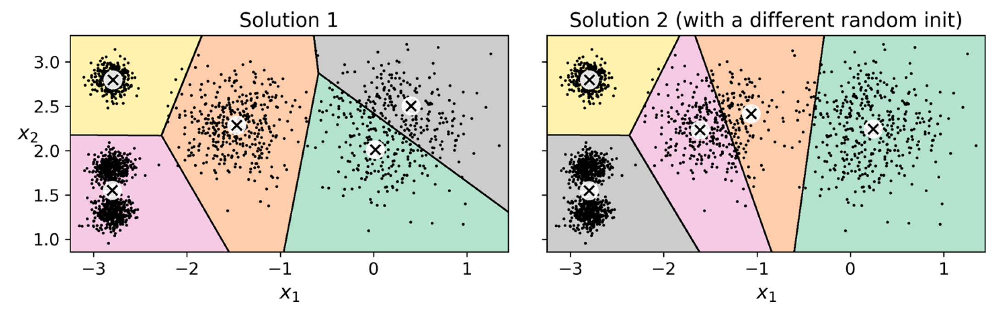
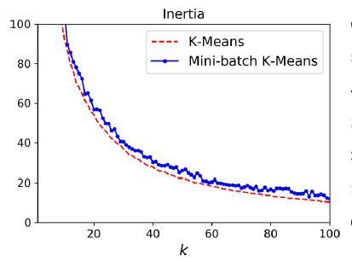
Iteratively minimizing the inertia (mean square distance to the closest centroid) does not guarantee a unique solution!
For reproducibility: Save your centroids ☺

Slide 20
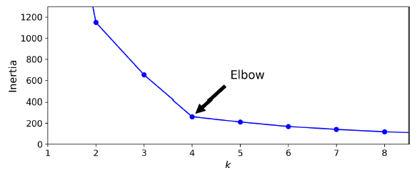
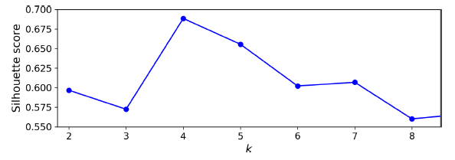
How to choose the number of clusters?
Inertia has elbow but not always enough to objectively choose k
Silhouette Score: Balancing distance to centroid with number of clusters
Notes:
VOTE NUMBER OF CLUSTERS

Slide 21
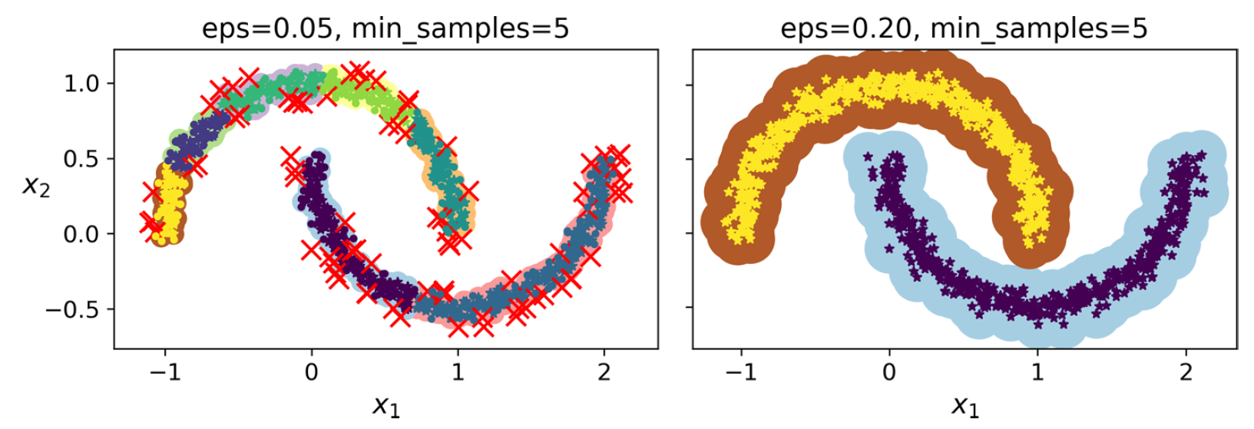
DBSCAN (Density-Based Spatial Clustering)
Hierarchical Clustering, Agglomerative Clustering, Spectral Clustering, etc.
Notes:
Other clustering algorithms include…
Conditions (question): the clusters must be dense enough and they must be separated by low-density regions

Slide 22
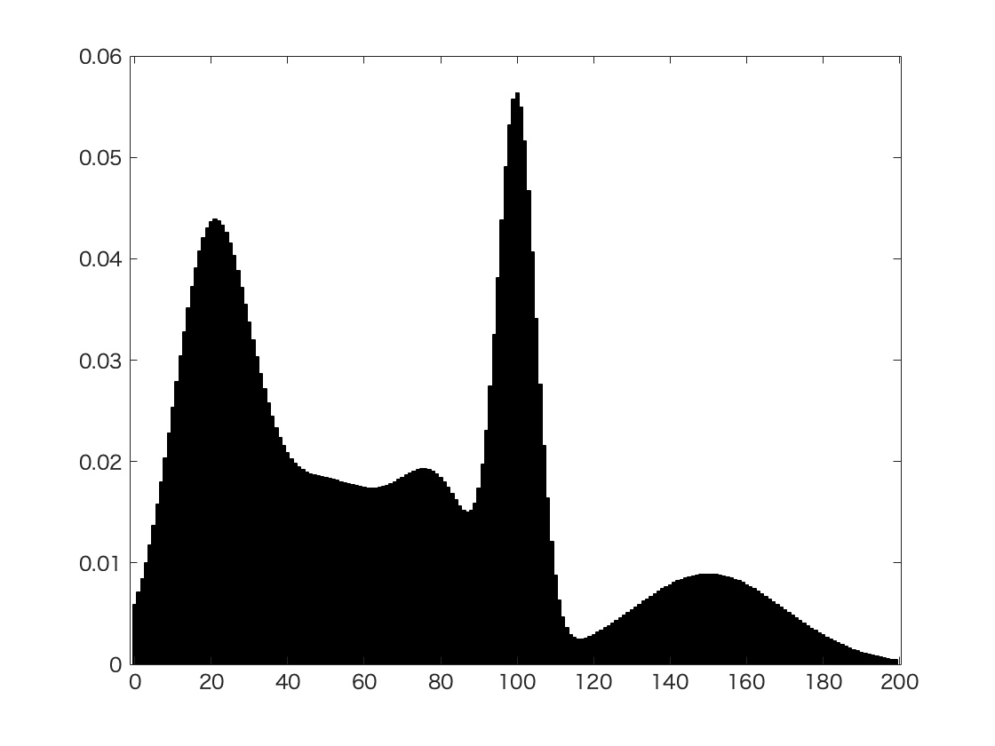
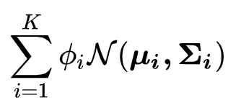
Gaussian Mixture Model = Sum Normal Distributions
Weights
Means
Covariances
Expectation-Maximization: Maximizes likelihood of being assigned to cluster
Source: Wikipedia (Mixture model)

Slide 23
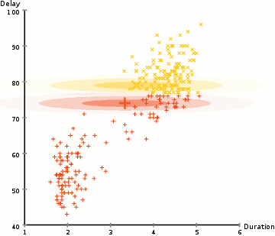
Gaussian Mixture Model = Sum Normal Distributions
Weights
Means
Covariances
Expectation-Maximization: Maximizes likelihood of being assigned to cluster
Source: Wikipedia (Mixture model; Expectation–max. algorithm)

Slide 24
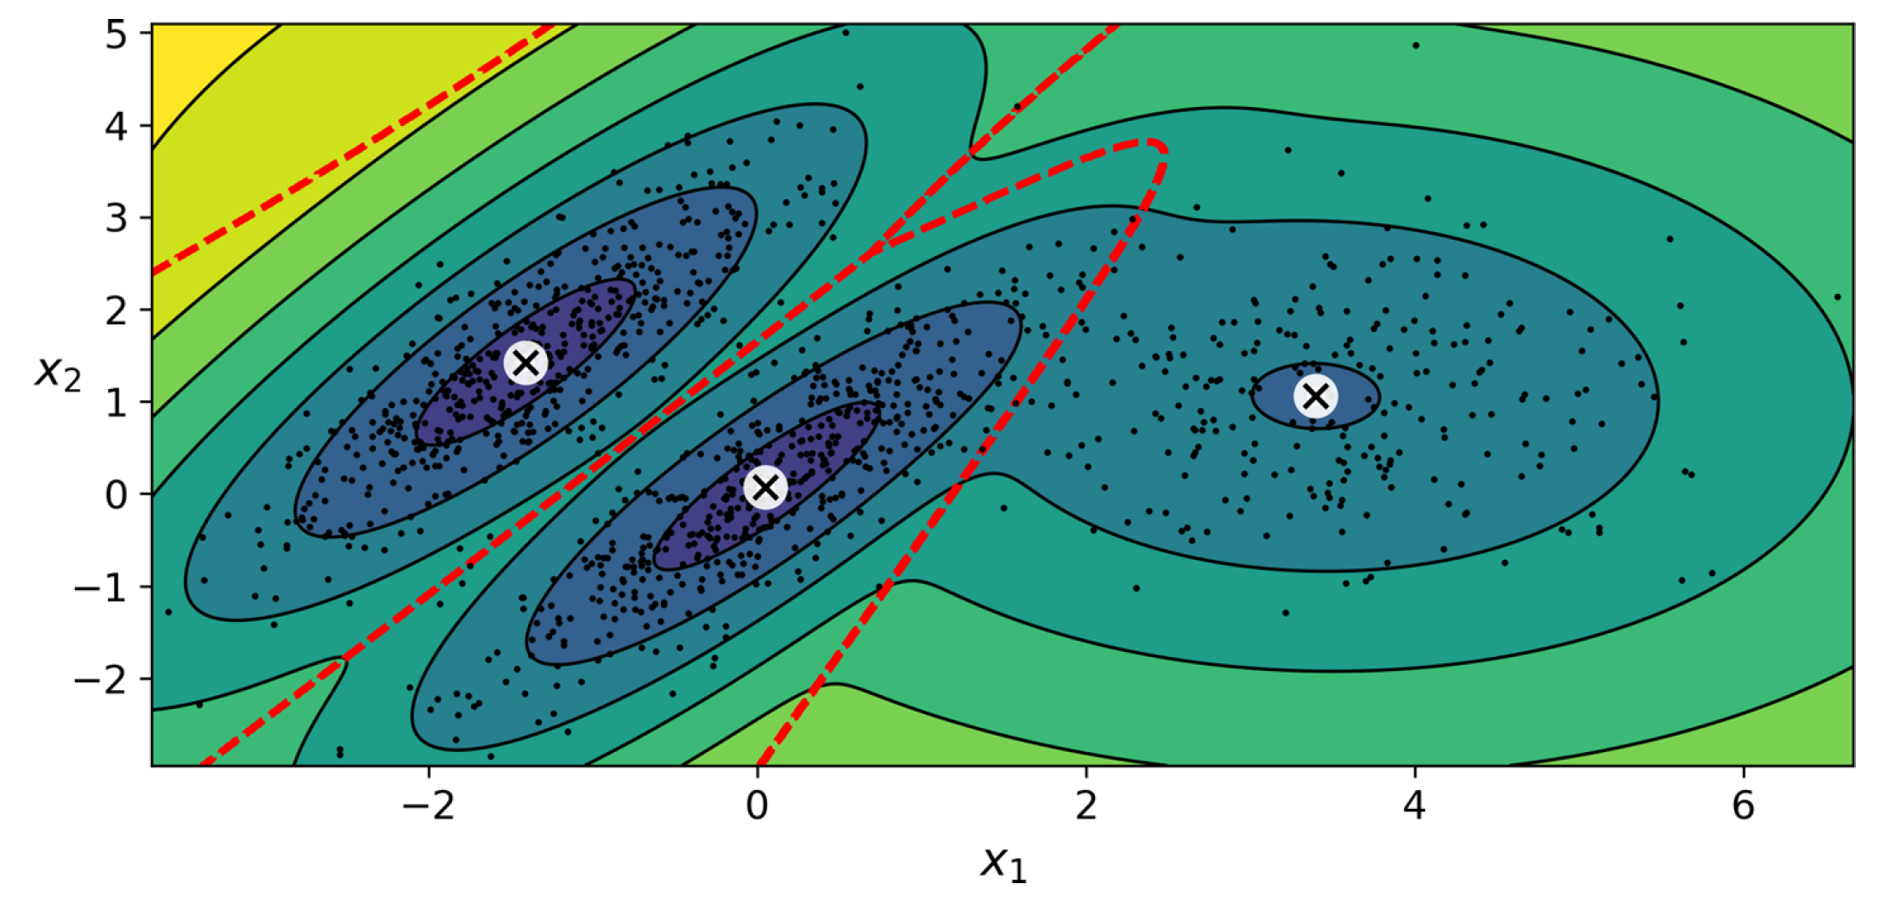
Means
Covariance matrices
Weight

Slide 25

Anomalies are points outside a given density threshold
Notes:
VOTE OUTLIERS?

Slide 26
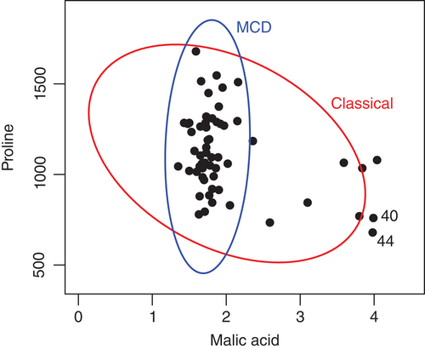
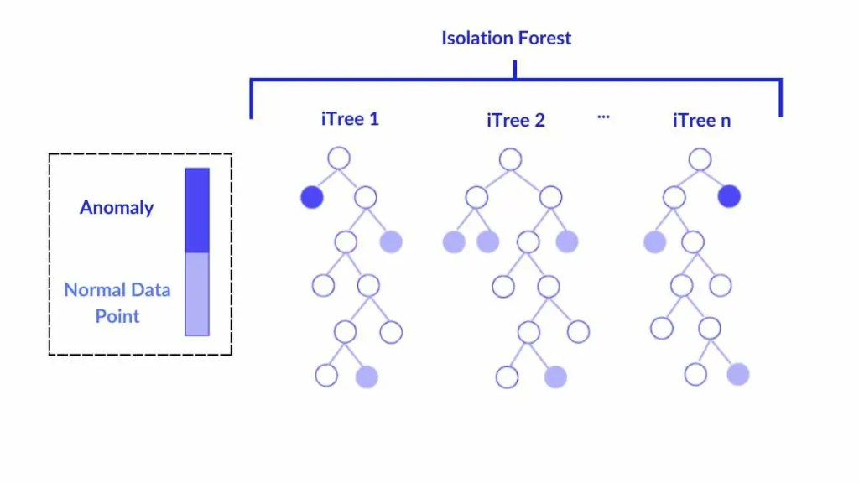
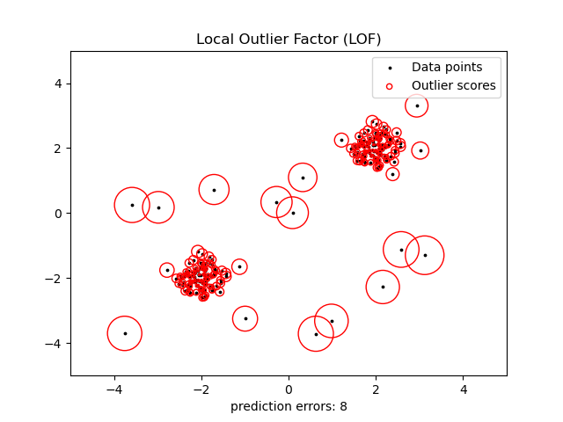
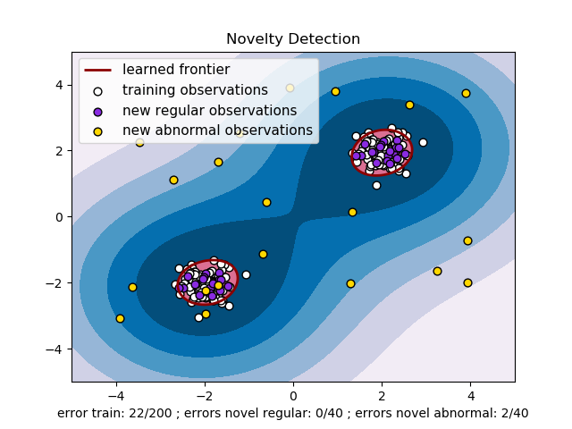
See Géron Ch. 9: Other Algorithms for Anomaly Detection
Fast-MCD
Mininum cov. determinant
Isolation forest
Local outlier factor (LOF)
1-class SVM
Source: Hubert et al. (2017), Van Otten (SI, 2024), scikit-learn

Slide 27
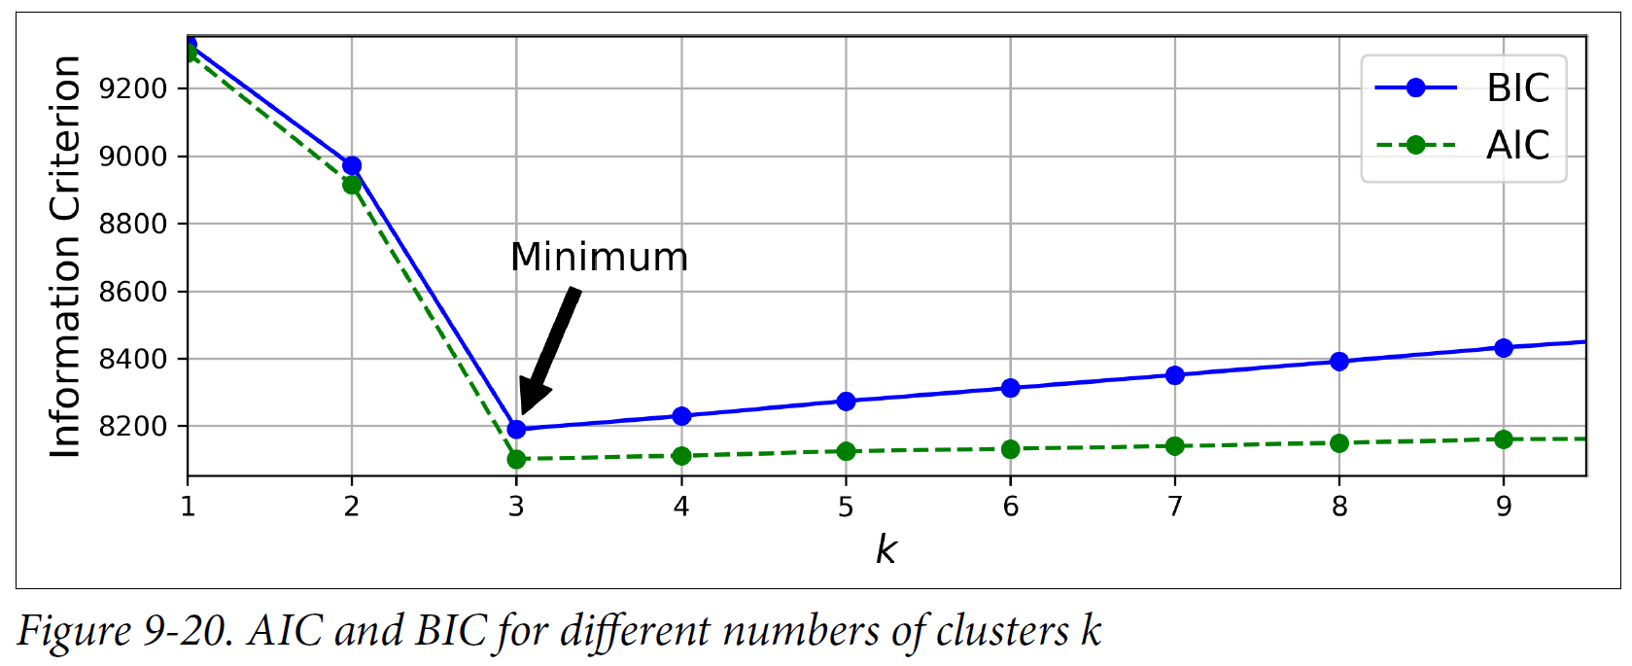
How to objectively choose number of clusters?
Minimize Information Criterion:
Bayesian Info. Criterion = ln(#samples) x (#param) – 2 (Likelihood)
Founded in Bayesian stats, penalizing #param (complexity) and variance error
Akaike Info. Criterion = 2 (#param) – 2 (Likelihood)
Founded in information theory & meant to discourage overfitting
2) Bayesian Gaussian mixture models eliminate unnecessary clusters

Slide 28
Min 105-120: Review Moodle Quiz
Learning Objectives (Moodle Quiz at Min 45 on Géron Ch5+6+7):
Name Support Vector Machines & understand their applicability
Know how to train & interpret a decision tree
Understand how to choose a regularization hyperparameter
Define a random forest
Know some advantages/drawbacks of ensemble modeling
Understand feature importance
Notes:
Questions?
Not graded

Slide 29
Legacy Slides

Slide 30
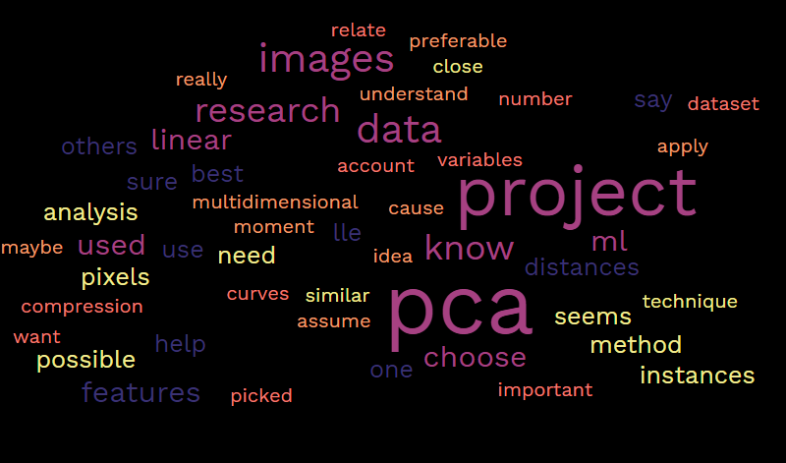
Fighting the curse of dimensionality
The higher the dimension, the higher the space. Therefore, the data will be more likely to be distant. This situation is not desirable because isolated data lose their usefulness. If we take for example 10 sampling points (of soil) in an area of 1m^2, we will have a good idea of the pesticide concentration. On the other hand, if we take 10 points in a 1m^3 cube, we will lose precision.
[…] the more features are used to describe data, the more isolated each datum point becomes and therefore the greater the risk of overfitting. Therefore, there is a tradeoff between the number of features considered individually and the generalization ability of the model.
(The) more we have information, the more samples is needed (this link grows exponentially). For example, if you want to know the predictions for the future climate. The more different factors we take, the more data we need to create our predictive model.

Slide 31
Question 3.3
Training Set
Validation Set
Test Set
Accuracy before decreasing complexity
0.92
0.51
0.56
Accuracy after decreasing complexity
0.21
0.15
0.18
Notes:
Know how to benchmark a regression model

Slide 32
Min 105-120: Review Moodle Quiz
Learning Objectives (Moodle Quiz at Min 45 on Géron Ch5+6+7):
Name Support Vector Machines & understand their applicability
Know how to train & interpret a decision tree
Understand how to choose a regularization hyperparameter
Define a random forest
Know some advantages/drawbacks of ensemble modeling
Understand feature importance
Notes:
Questions?
Not graded

Slide 33

Start thinking about your final project and book a one-on-one meeting
The final project’s goal is to answer a well-defined scientific question by applying one of the ML algorithms introduced in class on an environmental dataset of your choice (e.g., related to your Masters thesis or your PhD research).
Can you think of a large environmental dataset linked to a scientific question you are passionate about?
In the affirmative, how could you format the dataset to facilitate its manipulation in Python?
In the negative, consider browsing the Pangeo’s (http://mldata.pangeo.io/index.html), Kaggle’s, class syllabus’, or previous years’ datasets
Notes:
Questions?

Slide 34


Welcome back! Min 15-30: Quiz
ML for Earth & Env Sci (Week 2, FA2025)
Learning Objectives (Moodle Quiz at Min 45 on Géron Ch5+6+7):
Name Support Vector Machines & understand their applicability
Know how to train & interpret a decision tree
Understand how to choose a regularization hyperparameter
Define a random forest
Know some advantages/drawbacks of ensemble modeling
Understand feature importance
One-on-one meetings will continue on Friday – email me if you would like to book a 1-1 meeting with me next Friday (Oct 18)
Notes:
Thank you:
For coming today
To all of you who did the guided readings
For persevering

Slide 35
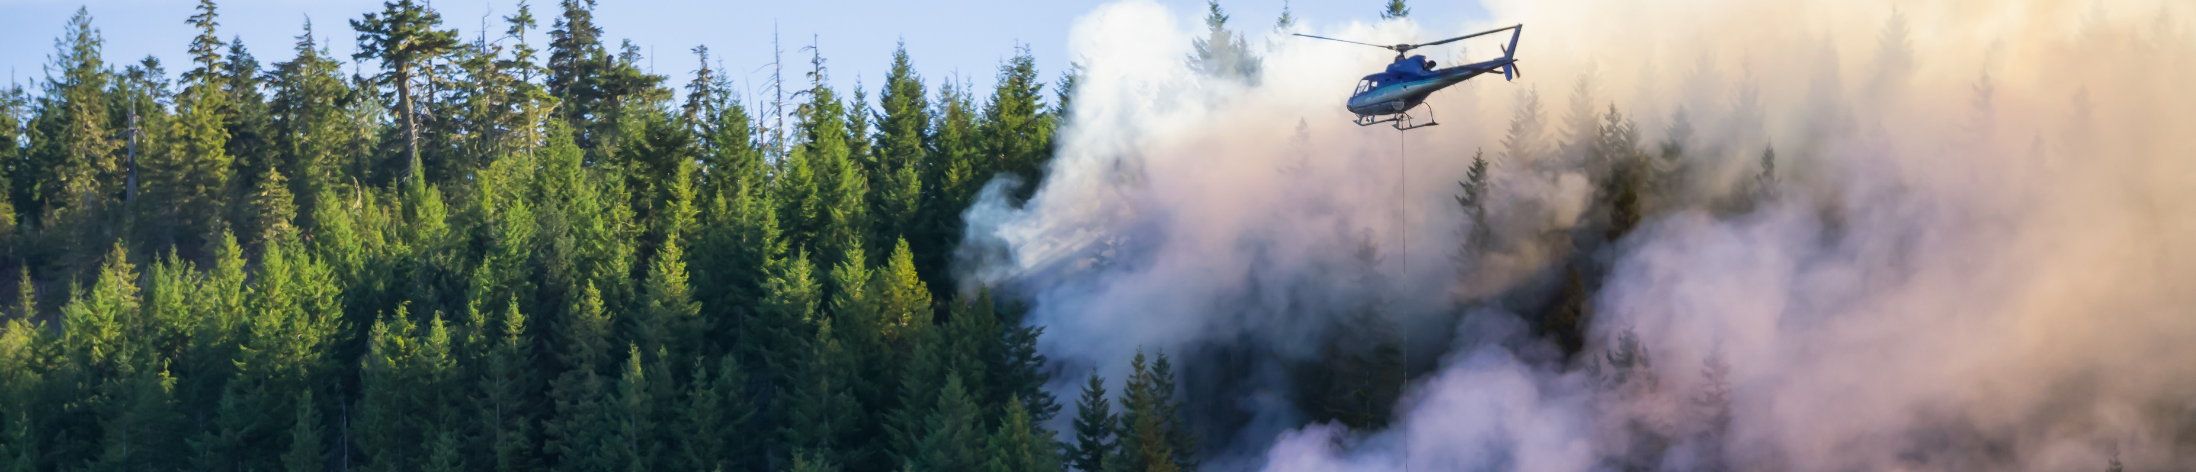
Min 30-60: Susceptibility mapping of Environmental Hazards using ML
Image
Re-read the article and write down (1) the scientific goal of the paper; (2) One simple question with your neighbor. Example: What is a susceptibility map?
Image Source: edb3_16

Slide 36
According to past data, which locations of the Liguria region are most susceptible to wildfires?
Problem: - Traditional susceptibility maps are not informed by data
- Statistical models only use a few years & do not separate by seasons
Idea: Train random forest to detect wildfires for 21y & use resulting probab.
Result: Susceptibility map indicating likelihood of wildfire events

Slide 37
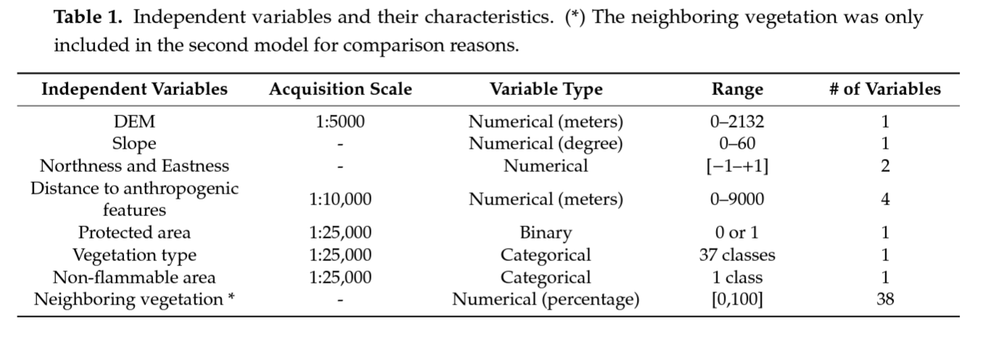

Slide 38
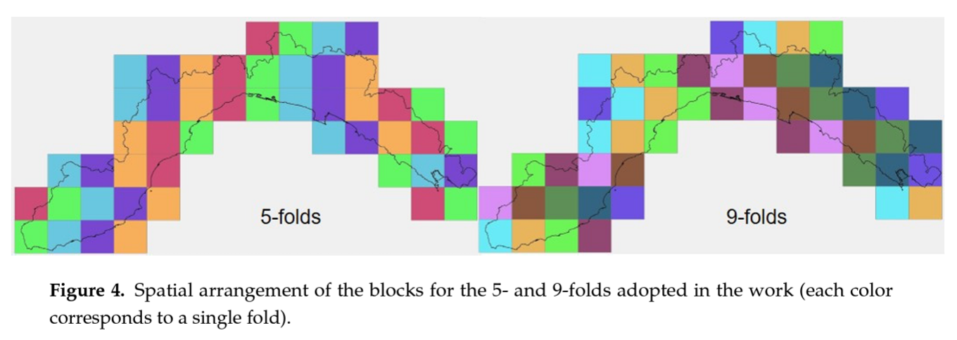

Slide 39
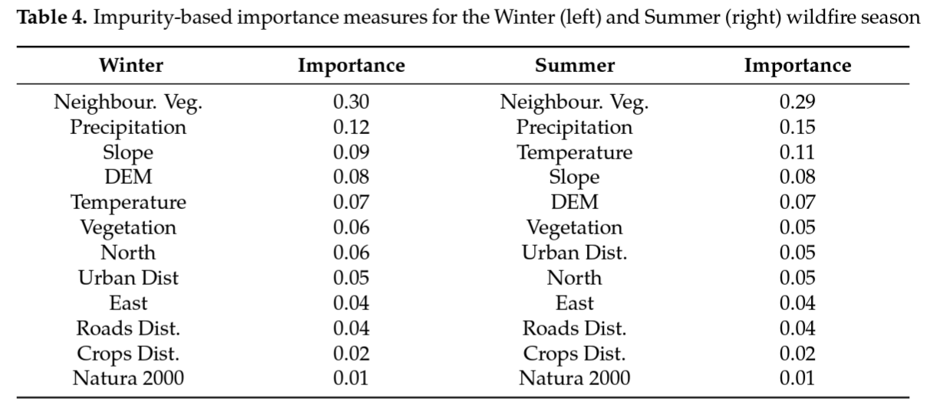

Slide 40

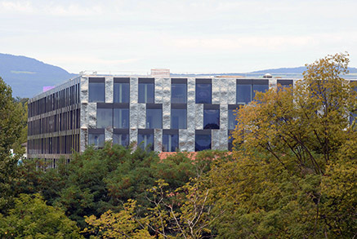
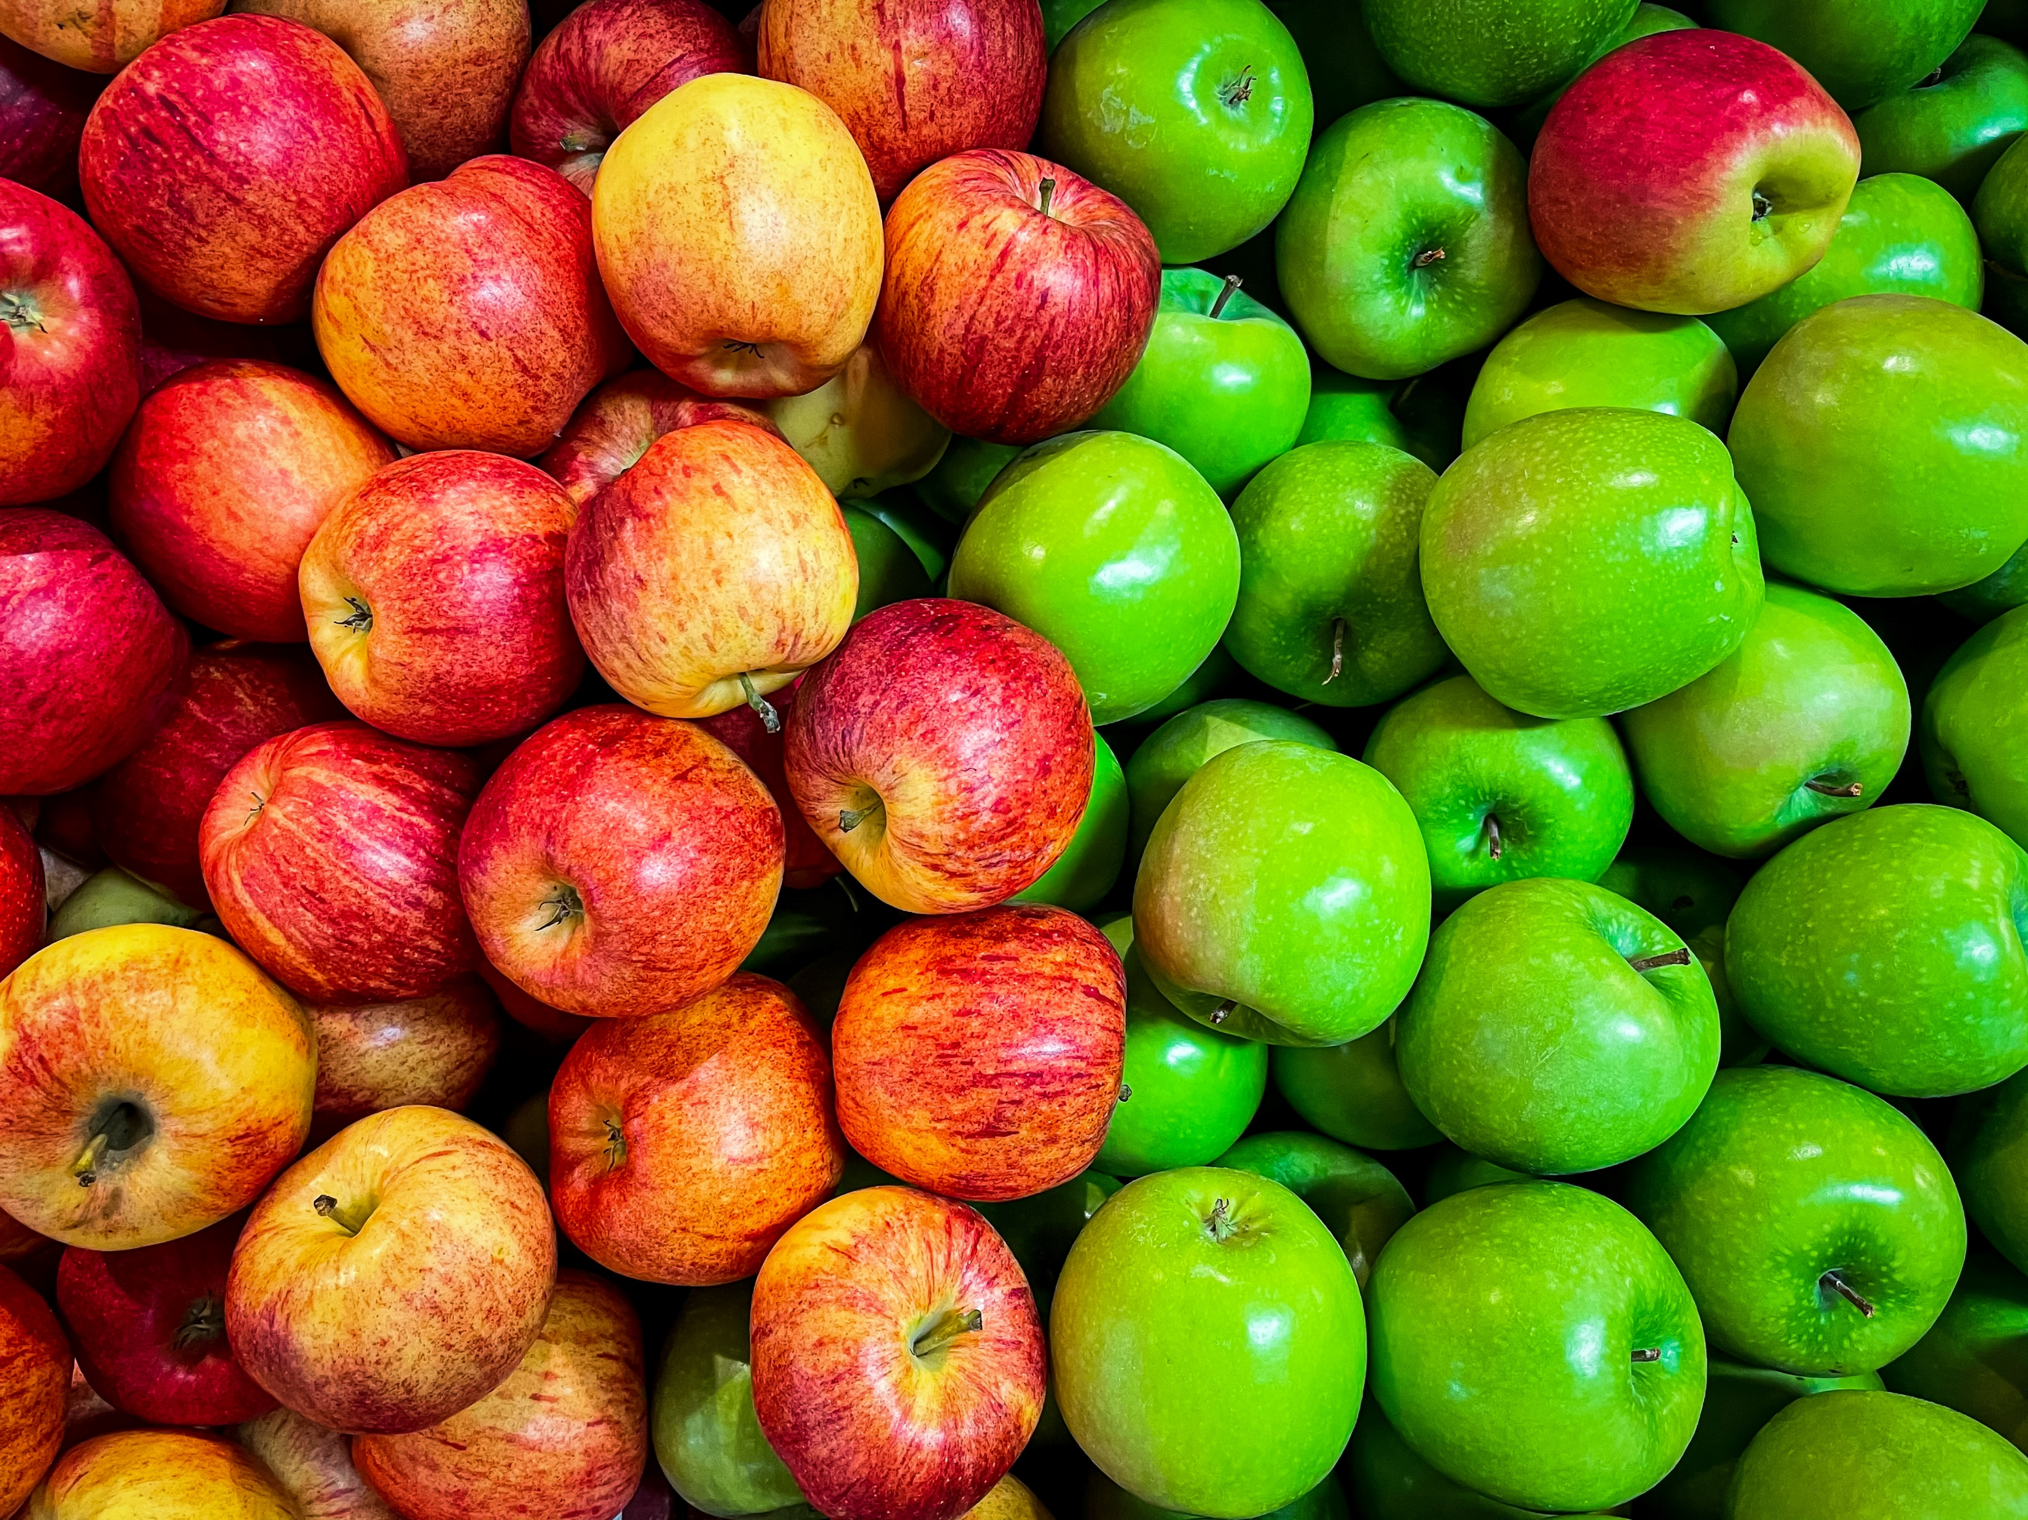
Min 60-75: Break

